Slide 1
A SECURE ERASURE CODE-BASED
CLOUD STORAGE SYSTEM
WITH SECURE DATA
FORWARDING
Submitted by
M Ravi Kumar
Roll No:10021F0006
M.C.A
Under The Guidance of
Smt. Ch.Ratna Kumari
Asst.Professor

Slide 2
ABSTRACT
The main technical contribution is that the proxy re-encryption scheme supports encoding operations over encrypted messages as well as forwarding operations over encoded and encrypted messages. Our method fully integrates encrypting, encoding, and forwarding.

Slide 3
ARCHITECTURE

Slide 4
EXISTING SYSTEM
General encryption schemes protect data confidentiality, but also limit the functionality of the storage system because a few operations are supported over encrypted data. Storing data in a third party’s cloud system causes serious concern on data confidentiality.

Slide 5
DISADVANTAGES OF EXISTING SYSTEM
There are three problems in the above straightforward integration of encryption and encoding. First, the user has to do most computation and the communication traffic between the user and storage servers is high. Second, the user has to manage his cryptographic keys.

Slide 6
PROPOSED SYSTEM
We propose a threshold proxy re-encryption scheme and integrate it with a decentralized erasure code such that a secure distributed storage system is formulated. The distributed storage system not only supports secure and robust data storage and retrieval, but also lets a user forward his data in the storage servers to another user without retrieving the data back.

Slide 7
ADVANTAGES OF PROPOSED SYSTEM
By using the threshold proxy re-encryption scheme, we present a secure cloud storage system that provides secure data storage and secure data forwarding functionality in a decentralized structure.

Slide 8
HARDWARE REQUIREMENTS
Processor - Pentium –III
Speed - 1.1 Ghz
RAM - 256 MB(min)
Hard Disk - 20 GB
Floppy Drive - 1.44 MB
Key Board - Standard Windows
Mouse - Two or Three Button Mouse
Monitor - SVGA

Slide 9
SOFTWARE REQUIREMENTS
Operating System : Windows XP
Application Server : Tomcat5.0/6.X
Front End : HTML, Java, JSP
Script : JavaScript.
Server side Script : Java Server Pages.
Database : MYSQL

Slide 10
MODULES:
Construction of Cloud Data Storage Module
Data Encryption Module
Data Forwarding Module
Data Retrieval Module

Slide 11
Construction of Cloud Data Storage Module
In Admin Module the admin can login to give his username and password. Then the server setup method can be opened. In server setup process the admin first set the remote servers IP-address for send that IP-address to the receiver. Then the server can skip the process to activate or Deactivate the process. For activating the process the storage server can display the IP-address. For deactivating the process the storage server cannot display the IP-address. These details can be viewed by clicking the key server. The activated IP-addresses are stored in available storage server. By clicking the available storage server button we can view the currently available IP-addresses.

Slide 12
Data Encryption Module
In cloud login module the user can login his own details. If the user cannot have the account for that cloud system first the user can register his details for using and entering into the cloud system. The Registration process details are Username, E-mail, password, confirm password, date of birth, gender and also the location. After entering the registration process the details can be stored in database of the cloud system. Then the user has to login to give his corrected username and password the code has to be send his/her E-mail. Then the user will go to open his account and view the code that can be generated from the cloud system.

Slide 13
Data Forwarding Module
In forward module first we can see the storage details for the uploaded files. When click the storage details option we can see the file name, question, answer, folder name, forward value (true or false), forward E-mail. If the forward column display the forwarded value is true the user cannot forward to another person. If the forward column display the forwarded value is false the user can forward the file into another person. In file forward processes contains the selected file name, E-mail address of the forwarder and enter the code to the forwarder. Now, another user can check his account properly and view the code forwarded from the previous user. Then the current user has login to the cloud system and to check the receive details. In receive details the forwarded file is present then the user will go to the download process.

Slide 14
Data Retrieval Module
In Download module contains the following details. There are username and file name. First, the server process can be run which means the server can be connected with its particular client. Now, the client has to download the file to download the file key. In file key downloading process the fields are username, filename, question, answer and the code. Now clicking the download option the client can view the encrypted key. Then using that key the client can view the file and use that file appropriately.

Slide 15
SCREEN SHOTS

Slide 16
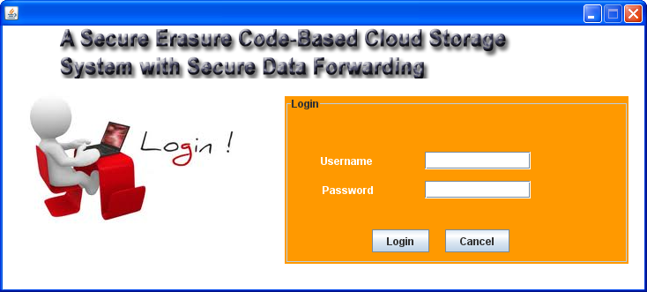
Cloud Storage Login:
User name: ravi
Password: ravi

Slide 17
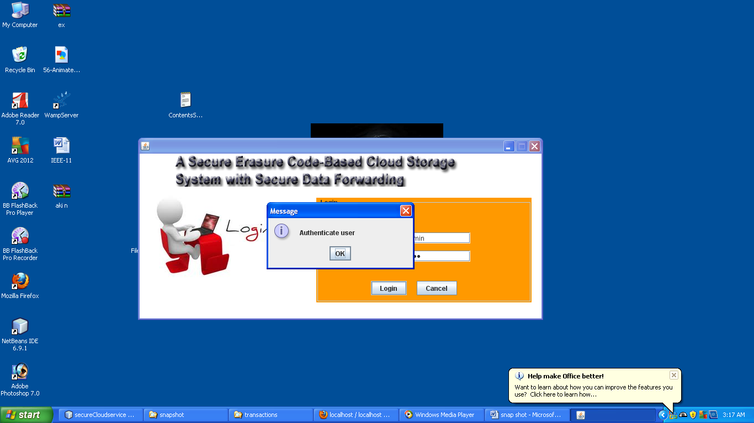

Slide 18
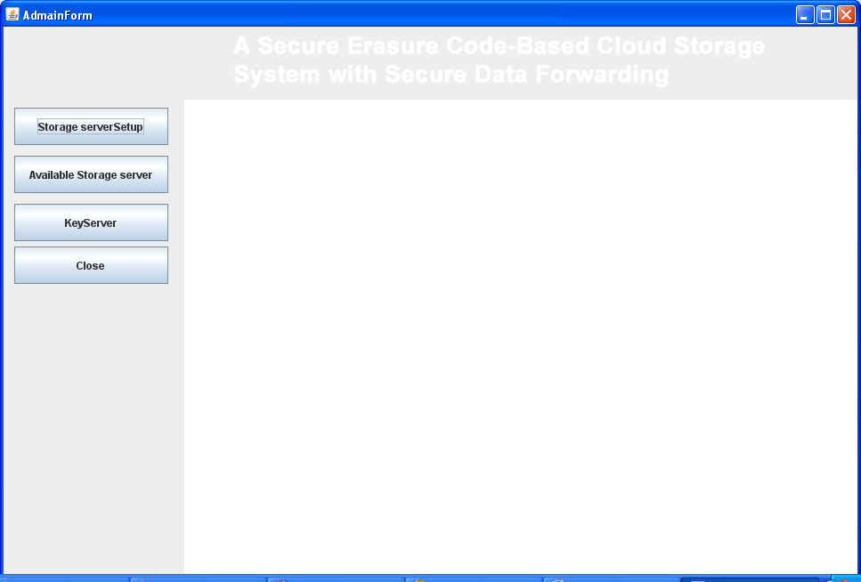
Storage setup:

Slide 19
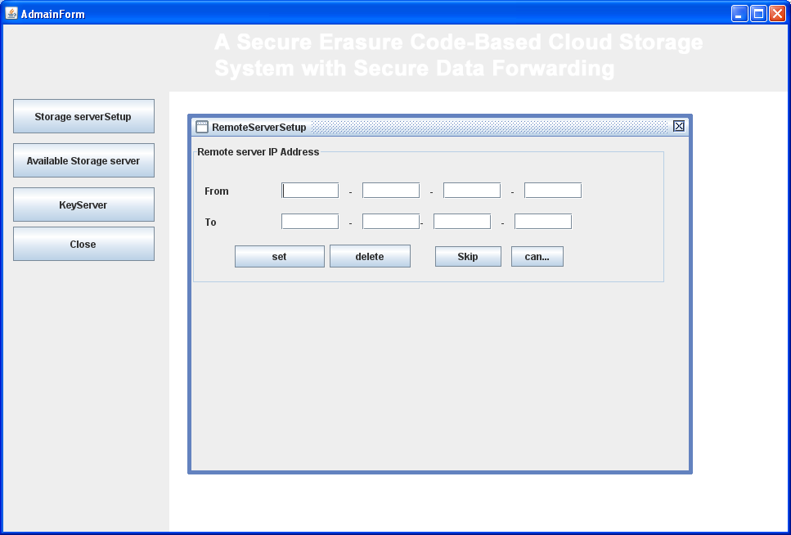
Remote Server setup:

Slide 20

IP-Address Setup:

Slide 21
Entering IP-Address:

Slide 22
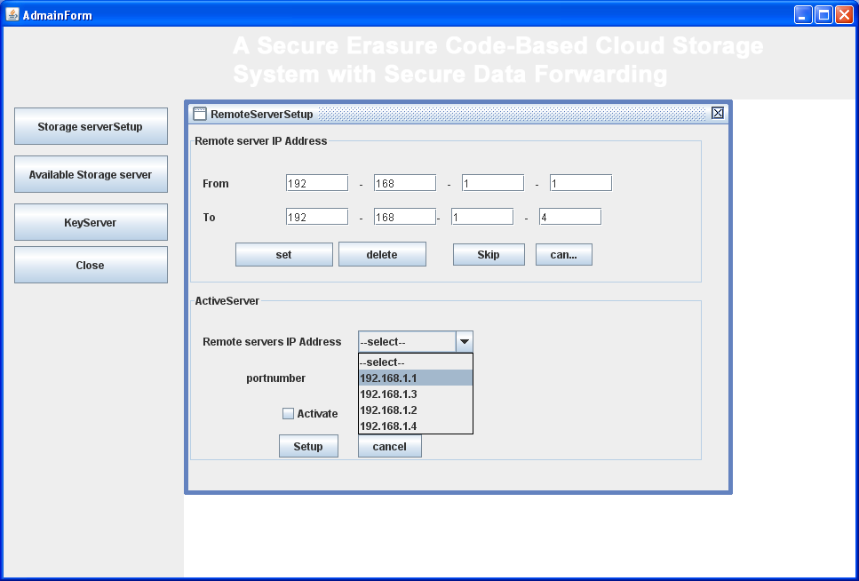
Select Skip:

Slide 23
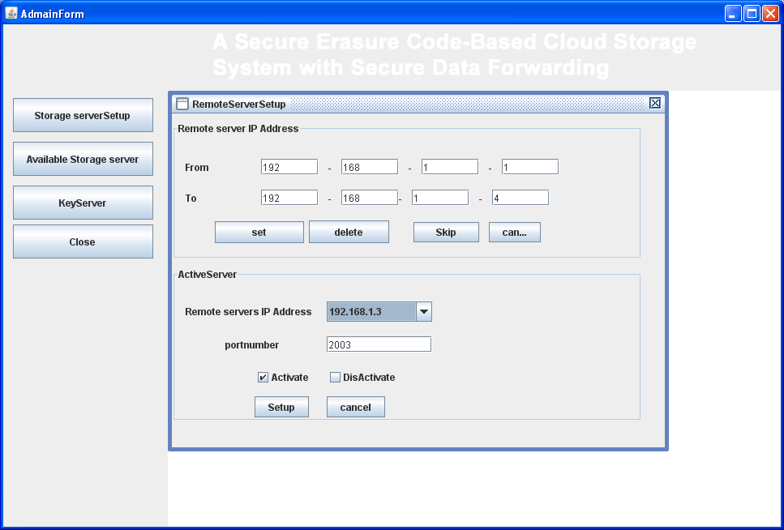
Selecting Server IP for activating or deactivating the server:

Slide 24
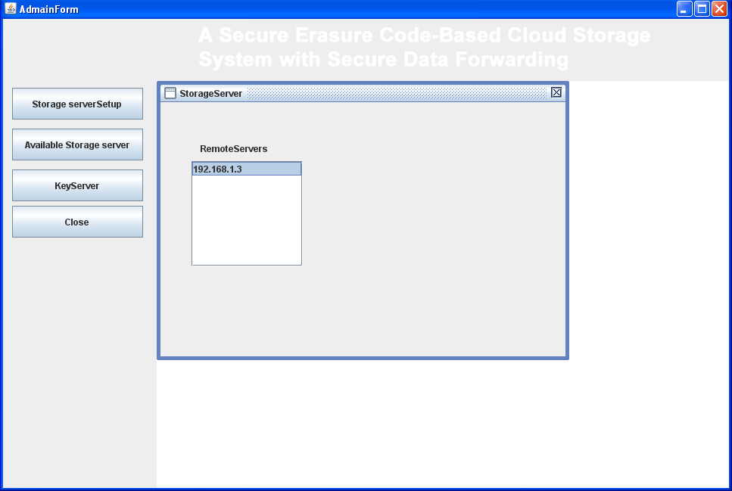
Available Storage Servers:

Slide 25
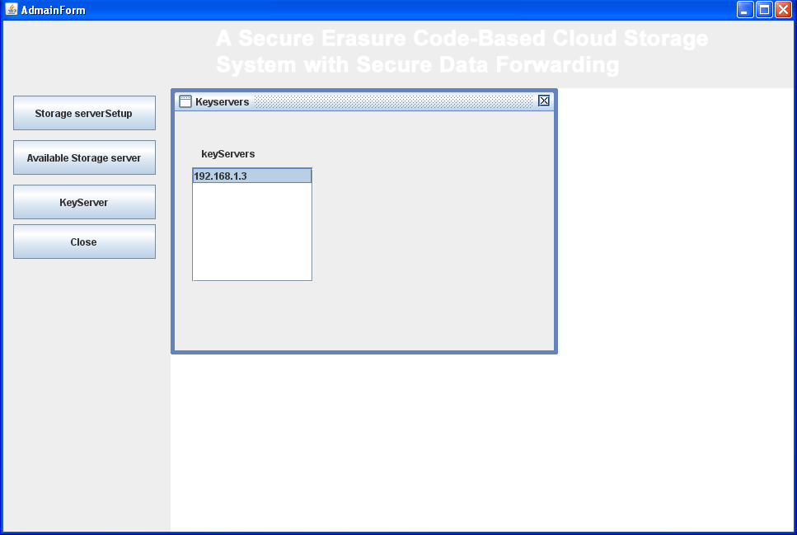
Available Key Servers:

Slide 26
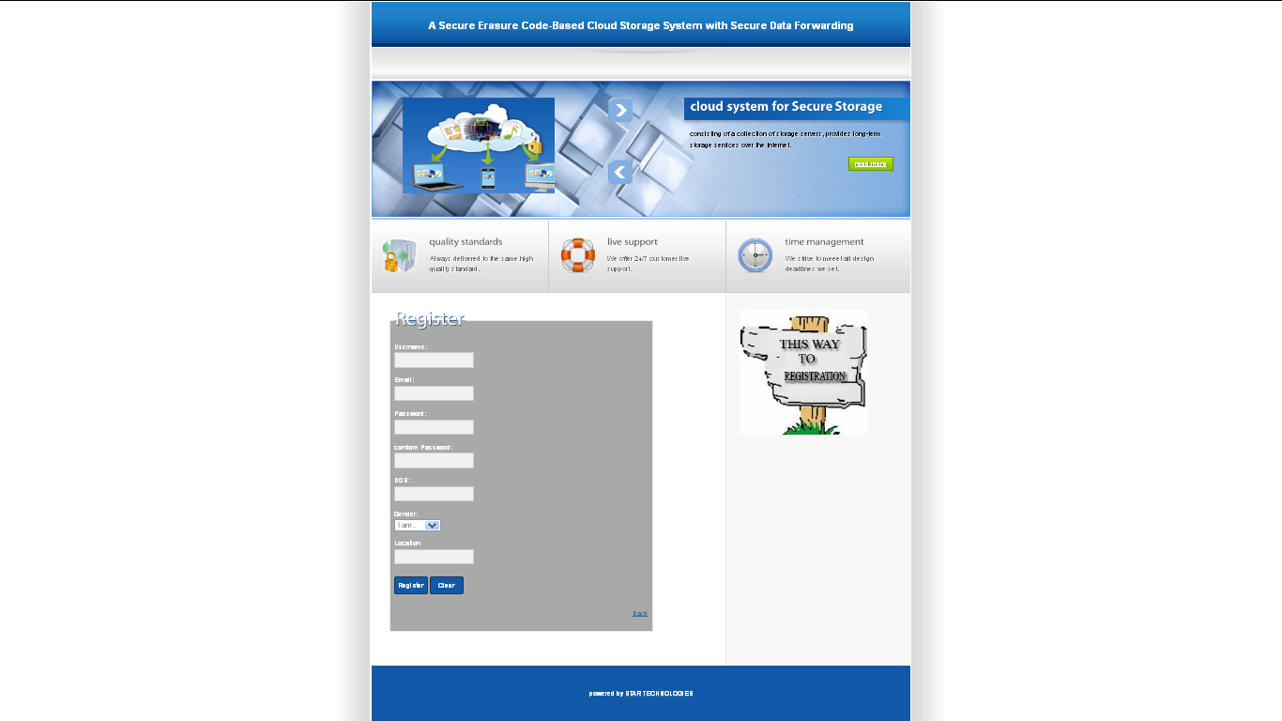
User Register Page:

Slide 27
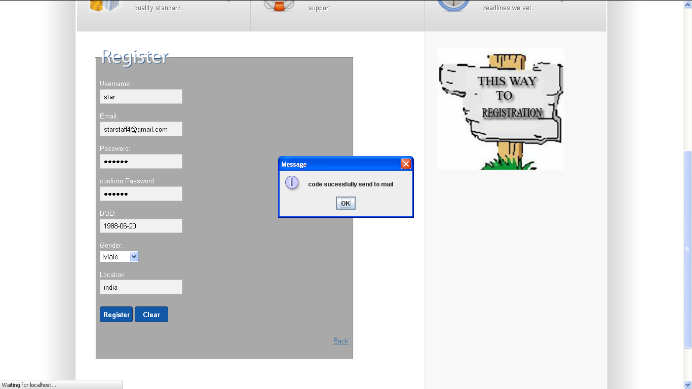
User registered and Code Successfully Sent to Email:

Slide 28
REFERENCE
Hsiao-Ying Lin, and Wen-Guey Tzeng, “A Secure Erasure Code-Based Cloud Storage System with Secure Data Forwarding” IEEE TRANSACTIONS ON PARALLEL AND DISTRIBUTED SYSTEMS, VOL. 23, NO. 6, JUNE 2012.

Slide 29
THANK YOU

